Slide 1



Requirements
Capabilities and conditions to which the system and more broadly, the project must
conform
A prime challenge of requirements work is to find, communicate, and record what is really needed, in a form that clearly speaks to the client and development team members.
functional (behavioral) or non-functional (everything else);
functional (behavioral)
calculations, technical details, data manipulation and processing and other specific
functionality
non-functional (everything else);
(also known as quality requirements), which impose constraints on the design or implementation (such as performance requirements, security, cost and reliability).

Slide 2





Types of Requirements: FURPS+
An acronym representing a model for classifying software quality attributes
(functional & non-functional requirements), First Developed at HP
Functionality—features, capabilities, security.
Usability—human factors, help, documentation.
Reliability—frequency of failure, recoverability, predictability Performance—response times, throughput, accuracy, availability, resource usage Supportability—adaptability, maintainability, internationalization, configurability.

Slide 3


Types of Requirements: FURPS+
The "+" in FURPS+ indicates ancillary and sub-factors, such as:
Implementation—resource limitations, languages and tools, hardware, ...
Operations—system management in its operational setting.
Packaging
Legal—licensing and so forth.

Slide 4


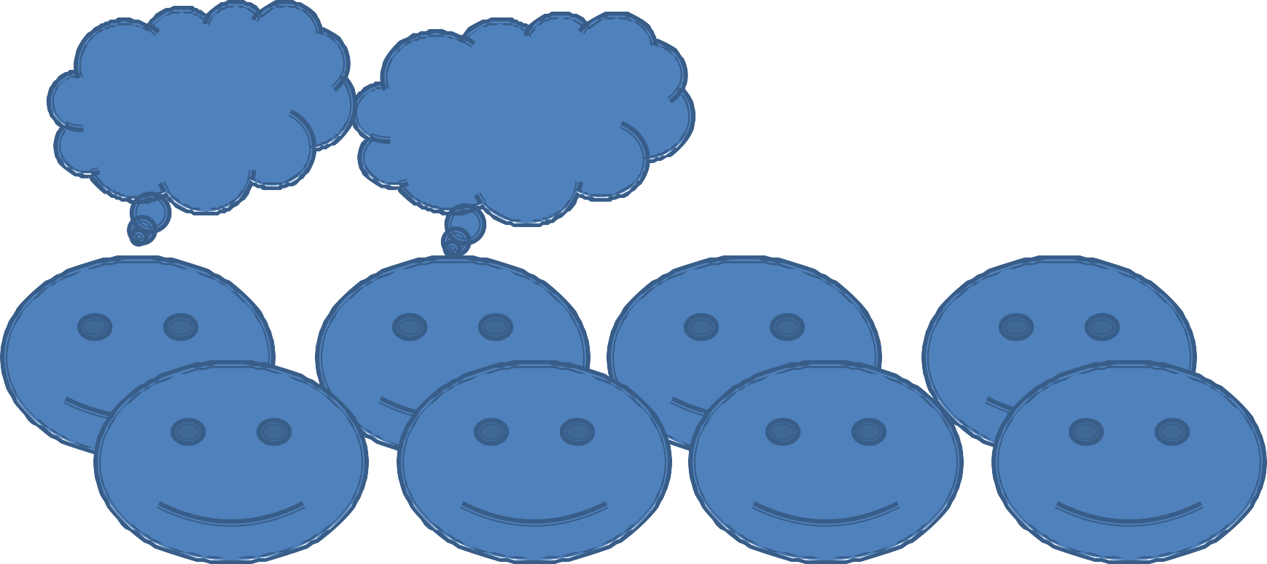

Interviewing
First Interview
What to say?
What if he misinterprets me?
Lets get over with it
It must succeed!!

Slide 5




Interviewing
The analyst starts by asking context-free questions;
a set of questions that will lead to a basic understanding of the problem, the people who want a solution, the nature of the solution desired, and the effectiveness of the first encounter itself.
Structured Questioning Techniques usually lead by software engineer :
–why are we building this system
–who are the other users
–determine critical functionality

Slide 6



Interviewing
Open-ended questions
–useful when not much is known yet
–examples "describe X " tell me what you do
Closed-ended questions
–when enough about the system is known try to ask specific questions
–example "how often should sales reports be generated?”
Try to proceed from open-ended to closed-ended questions!!

Slide 7



Interviewing
rephrase answers
–make sure you understood the client's answer, check for errors, inconsistencies and ambiguities
Find out who else to interview
–who else uses the system
–who interacts with you
–who will agree / disagree with you
The Q&A session should be used for the first encounter only and then be replaced by a meeting format that combines elements of problem solving, negotiation, and specification.

Slide 8

Interviewing
Customers and software engineers often have an unconscious "us and them"
mindset.
Rather than working as a team to identify and refine requirements, each constituency defines its own "territory" and communicates through a series of memos, formal position papers, documents, and question and answer sessions.

Slide 9


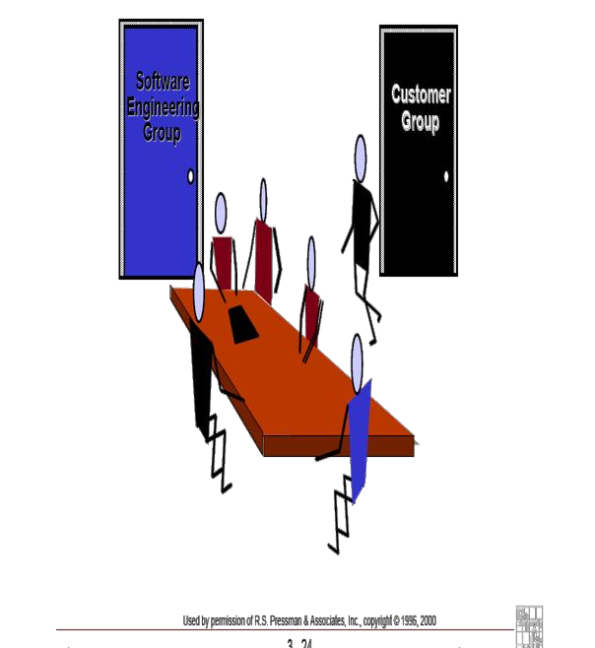
FAST
facilitated application specification techniques (FAST), this approach encourages the creation of a joint team of customers and developers who work together to identify the problem, propose elements of the solution, negotiate different approaches, and specify a preliminary set of requirements.

Slide 10
FAST
Facilitated Application Specification Technique (FAST)
♦Idea overcome we/them attitude between developers and users team-oriented approach
Guidelines
–participants must attend entire meeting
–all participants are equal
–preparation is as important as meeting
–all pre-meeting documents are to be viewed as “proposed”
–off-site meeting location is preferred
–set an agenda and maintain it
–don’t get mired in technical detail
Approaches to FAST
–Joint Application Design (IBM)
–The Method (Performance Resources)

Slide 11

JAD
JAD stands for Joint Application Development.
Sit down with the client and design a paper UI that they can see what the application will look like and behave like.
Give the user a chance to work through common scenarios and see if the application will work for them.
Keep refining until the user feels the application is doing what they want it to do.
As you get functionality implemented, bring the user in and have them work through those scenarios and see if it still works.
If they want a change, have a solid estimate of how long the change will add to the schedule and how much it will cost.

Slide 12


UP Artifacts
Requirements
Business Model
Op. Contract
Method( )
Operation
Post-conditions
Starting events
Domain Model
Sys. Seq. Diagram
Use Case Title
Suggestions for names
Functional requirements
1.
2.
…
…
method1( )
Glossary
method2( )
method3( )
Item details
Interaction Diagrams
Domain rules
Non-functional requirements
Supplementary Specification
Design Class Diagram
Design Model

Slide 13

Determining Visibility
Sale | Captured on | Register |  | Produce Catalogue
timeStamp
Domain Model
Process Sale
Process Sale
Cashier
1.
2.
Customer arrives
Cashier makes new sale….
conceptual classes in the domain inspire the names of some software classes in the design
makeNewSale( )
System Events
enterItem(id,quantity )
Use Case
Use Case Model
Sys. Seq. Diagram
Use Case Diagrams
:Register
:ProductCatalogue
makeNewSale( )
create( )
:Sale
enterItem(id,quantity )
spec:=getSpecification(id)
addLineItem(spec, quantity)
the design classes discovered while designing UCRs can be summarized in class diagrams
Register
makeNewSale( ) enterItem(id,quantity )
ProductCatalogue
getSpecification( ) …………………..
1
1
Design Model

Slide 14


Object-oriented Analysis
OOA — Decomposition of a domain into noteworthy concepts or objects
DM — visual representation of above in simple UML
Other names: conceptual models, domain object model, analysis object model
Bounded by a specific domain as described in use cases
Concepts not software classes (these are in domain layer )

Slide 15

How to Create a Domain Model — Three Steps
Find the domain concepts
Draw them in a UML class diagram
Add associations and attributes
Domain concepts — noteworthy abstractions, domain vocabulary — idea, thing or object (Payment, Sale)
Associations — relationships between concepts (Payment Pays-For Sales
Attributes – information content (Sale records date and time)

Slide 16

Domain Concepts
Noun phrase identification
Use with category lists
Sources: Use cases, domain experts, other documents
Customer arrives at POS Checkout with goods to purchase
- Ambiguities: goods, products, items

Slide 17






Domain Concepts (Conceptual Classes)
Symbol — words or images representing the concept
Intention — definition of the concept
Extension — the set of examples to which the concept applies
Sale
Concepts Symbol
date time
sale
A sale represents the event of a purchase transaction.. It has a date and time.
Concepts Intension
Sale-1
Concepts Extension
Sale-3
Sale-2

Slide 18
Domain Concepts (Conceptual Classes)
Symbol — Card
Intention — represents one card in a poker deck that has a rank (2..14) and a suit
Extension — the set of all cards
CardDeck
Concepts Symbol
rank suit
sale
A card represents one of the enities to make up a hand in a poker game
Concepts Intension
Ace
Concepts Extension
3
2

Slide 19
Object-oriented Analysis
Conceptual Models
concepts
*
Book
0..1
Borrows
Patron
title
Conceptual models represent ideas, things, and objects in the real-world problem domain.
A concept is a set of examples of like things.
Example: All library patrons.

Slide 20
Object-oriented Analysis
Identifying Concepts in the Domain
Create a list of candidate concepts from common concepts list.
Concept Category Tangible or physical objects Places
Transactions Transaction line items Roles of people
Specifications or descriptions Scheduled events
Examples
Book Library
ResourceLoan, Sale SalesLineItem Librarian, Patron
ProductSpecification Appointment, Flight

Slide 21
Object-oriented Analysis
Dimensions of Decomposition
Conceptual modeling emphasizes decomposition by things.
The Library Information System
Object-oriented A/D
Structured A/D
Decompose by objects or concepts
Decompose by functions or processes
System
Catalog
Librarian
Record Loans
Add Resources
Report Fines
Book
Library

Slide 22
Object-oriented Analysis
Associations
Are noteworthy relationships between concepts.
Are bidirectional.
Should have a meaningful name.
form: <Noun> <Verb-phrase> <Noun>
0..1
Borrows
*
Book
Patron
title
association

Slide 23
Object-oriented Analysis
Multiplicity
0..1
*
Book
Patron
Borrows
title
multiplicity
*
*
0..2
= (Zero or more)
1..
= (One to many)
= (Zero or more)
40
= (Exactly specified)
= (Zero to two)
1,3,5
= (One or three or five)

Slide 24
Object-oriented Analysis
Roles
Each end of an association is a role having:
Navigability
Multiplicity.
An optional name.
0..1 Borrows *
borrower
Book
Patron
title
role

Slide 25
Object-oriented Analysis
Reading Direction Arrow
An association can have an optional reading direction arrow.
Aids in reading only.
Has no semantic meaning.
reading direction arrow
*

Borrows
1
Book
Patron

Slide 26
Object-oriented Analysis
Identifying Important Associations
When show? — If memory of relationship needs to be preserved for some duration.
Common association categories.
Association Category
A is part of B
A is a line item of B
A is contained within B A is a member of B
A is an organizational subunit of B
A is a policy related to B
Examples
Sentence—Paragraph
SalesLineItem—Sale Book—Library Librarian—Library
Department—Company LoanPolicy—Book

Slide 27
Object-oriented Analysis
Identifying Important Associations
Examples
Book—Catalog Loan—Library
Patron—Library
Patron ResourceLoan Patron—Librarian
Association Category
A is recorded in B
A uses or manages B
A is related to a transaction of B A communicates with B
—
A is a transaction related to another _{Loan—Return}
transaction B A is next to B
A is related to B via a transaction
ChessSquare ChessSquare
Patron—Librarian Husband—Wife
—

Slide 28
Object-oriented Analysis
Attributes
wrong
Only simple attributes.
Examples: number, string, boolean, date, time.
No foreign keys.
Office
Employee
roomNum
name
office
wrong
Office
Employee
roomNum
name
officeNum

Slide 29


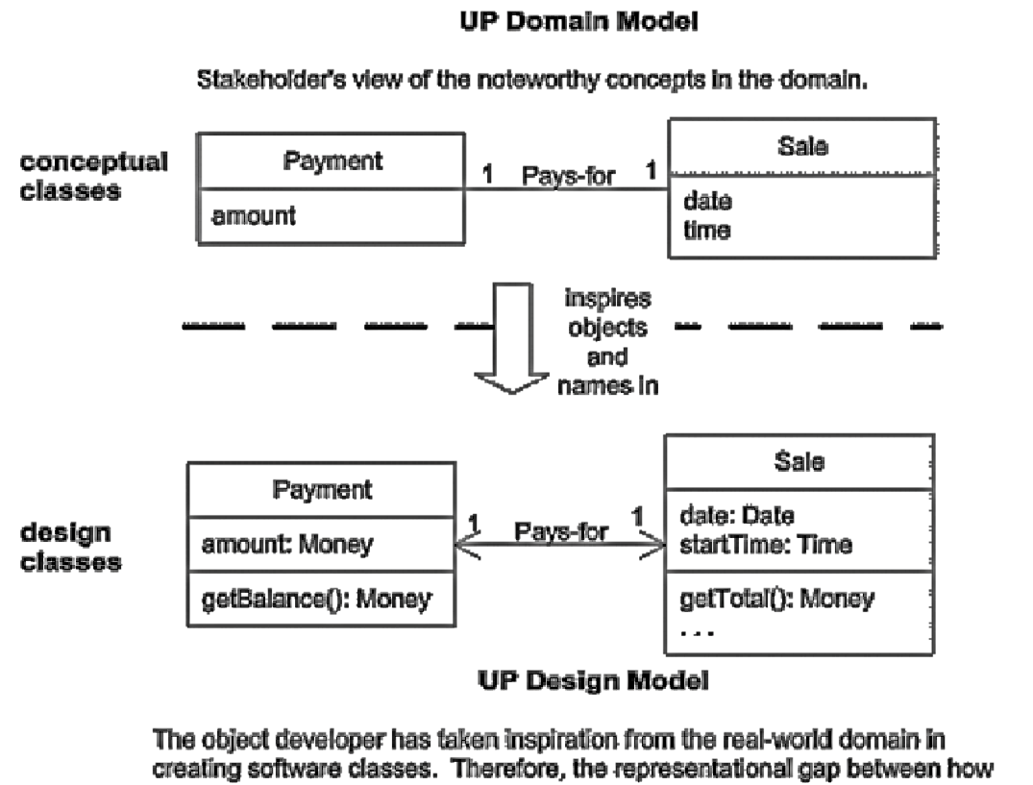
Attributes — When?
Requirements suggest or imply a need to remember information
Sale needs a dateTime
Store needs a name and address Sale needs a dateTime
Store needs a name and address Sale needs a dateTime
Store needs a name and address

Slide 30
Object-oriented Analysis and Design
Attributes
Relate concepts with an association, not an attribute.
Employee
Office
Occupies
name
1
1 roomNum
Logical data value of a concept Add attributes to fulfill the information needs of the requirements

Slide 31
Attributes vs. Domain Concepts vs.
Associations
Something which is a number or text (primitive data type) in real world is most likely an attribute Phonenumber, Name, Date
Complex domain concepts should be related by associations not attributes
Cashier
Worse
name currentRegister
Not a simple attribute!!
Cashier
Register
Better
uses
name
1
1 number

Slide 32
Object-oriented Analysis
Flight
Worse
Destination is a complex concept!!!!
destination
Flies-to
Better
Flight
Airport
1
1

Slide 33
Object-oriented Analysis
Sale
Domain concept
Date Time
Attributes
1
1
Captured-on
Paid-by
1
Payment
Register
1
amount
Association

Slide 34



use cases
Writing use cases—stories of using a system—is an excellent technique to understand and describe requirements.
Informally, they are stories of using a system to meet goals.
the essence is discovering and recording functional requirements by writing stories of using a system to help fulfill various stakeholder goals

Slide 35






Black-Box Use Cases and System Responsibilities
It does not describe the internal workings of the system, its components, or design.
Rather, the system is described as having responsibilities, software elements have responsibilities and collaborate with other elements that have responsibilities.
To specify what the system must do (the functional requirements) without deciding how it will do it (the design).
Analysis
Design
Vs
What
How

Slide 36

Different formats of use cases :
1. Brief—terse one-paragraph summary, usually of the main success scenario.
Process Sale: A customer arrives at a checkout with items to purchase. The cashier uses the POS system to record each purchased item. The system presents a running total and line-item details. The customer enters payment information, which the system validates and records. The system updates inventory. The customer receives a receipt from the system and then leaves
with the items

Slide 37

Different formats of use cases :
2. Casual—informal paragraph format. Multiple paragraphs that cover various scenarios.
Handle Returns
Main Success Scenario: A customer arrives at a checkout with items to return. The cashier uses the POS system to record each returned item ...
Alternate Scenarios:
If the credit authorization is reject, inform the customer and ask for an alternate payment method.
If the item identifier is not found in the system, notify the Cashier and suggest manual entry of the identifier code (perhaps it is corrupted).
If the system detects failure to communicate with the external tax calculator system, ...

Slide 38


Different formats of use cases :
3.fully dressed—the most elaborate. All steps and variations are written in detail, and there are supporting sections, such as preconditions and success guarantees.
Use Case UC1: Process Sale Primary Actor: Cashier Stakeholders and Interests: Preconditions:
Success Guarantee (Postconditions): Main Success Scenario (or Basic Flow): Extensions (or Alternative Flows): Special Requirements:
Technology and Data Variations List:

Slide 39

Different formats of use cases :
Use Case UC1: Process Sale Primary Actor: Cashier Stakeholders and Interests:
-Cashier: Wants accurate, fast entry, and no payment errors, as cash drawer short ages are deducted from his/her salary.
Salesperson: Wants sales commissions updated.
-Customer: Wants purchase and fast service with minimal effort. Wants proof of purchase to support returns.
Company: Wants to accurately record transactions, satisfy customer interests.
Wants to ensure that Payment Authorization Service payment receivables are recorded.
Wants some fault tolerance to allow sales capture even if server components (e.g., remote credit validation) are unavailable.
Wants automatic and fast update of accounting and inventory.
Government Tax Agencies: Want to collect tax from every sale. May be multiple agencies, such as national, state, and county.
-Payment Authorization Service: Wants to receive digital authorization requests in the correct format and protocol.
Wants to accurately account for their payables to the store.

Slide 40
Different formats of use cases :
Preconditions: Cashier is identified and authenticated.
Success Guarantee (Postconditions): Sale is saved. Tax is correctly calculated. Accounting and Inventory are updated. Commissions recorded. Receipt is generated. Payment authorization approvals are recorded.
Main Success Scenario (or Basic Flow):
Customer arrives at POS checkout with goods and/or services to purchase.
Cashier starts a new sale.
Cashier enters item identifier.
System records sale line item/presents item description, price, running total. Price calculated from a set of price rules.
System presents total with taxes calculated.
Cashier tells Customer the total, and asks for payment.
Customer pays and System handles payment.
System logs completed sale and sends sale and payment information to the external Accounting system (for accounting and commissions) and Inventory system (to update inventory).
System presents receipt.
Customer leaves with receipt and goods (if any).

Slide 41
Different formats of use cases :
Extensions (or Alternative Flows):
*a. At any time, System fails:
To support recovery and correct accounting, ensure all transaction sensitive state and events can be recovered from any step of the scenario.
Cashier restarts System, logs in, and requests recovery of prior state.
System reconstructs prior state.
2a. System detects anomalies preventing recovery:
System signals error to the Cashier, records the error, and enters a clean state.
Cashier starts a new sale. 3a. Invalid identifier:
1. System signals error and rejects entry.
3b. There are multiple of same item category and tracking unique item identity not important (e.g., 5 packages of veggie-burgers):
1. Cashier can enter item category identifier and the quantity. 6a: Customer asks Cashier to remove an item from the purchase:
1. Cashier enters item identifier for removal from sale.

Slide 42

Different formats of use cases :
Frequency of Occurrence: Could be nearly continuous.
Open Issues:
What are the tax law variations?
Explore the remote service recovery issue.
What customization is needed for different businesses?
Must a cashier take their cash drawer when they log out?
Can the customer directly use the card reader, or does the cashier have to do it?

Slide 43


Different formats of use cases :
Preconditions state what must always be true before beginning a scenario
in the use case.
A precondition implies a scenario of another use case that has successfully completed, such as logging in, or "cashier is identified and authenticated”.
^{S}S^{u}u^{c}c^{c}c^{e}e^{s}s^{s}s^{g}G^{u}uªa^{ra}ra^{n}n^{te}tee^{s} (Po^{r} s^{p}tºc^{s}o^{t}n^{c}dºi^{n}t^{d}io^{it}n^{i}sº)^{n}s^{s}t⁾ates what must be true on successful completion of the use case. either the main success scenario or some alternate path.
The guarantee should meet the needs of all stakeholders. Sale is saved. Tax is correctly calculated.
Accounting and Inventory are updated. Commissions recorded. Receipt is generated.

Slide 44


Different formats of use cases :
Extensions (or Alternate Flows)
They indicate all the other scenarios or branches, both success and failure. They are also known as "Alternative Flows."
Special Requirements
If a non-functional requirement, quality attribute, or constraint relates specifically to a use case, record it with the use case. These include qualities such as performance, reliability, and usability, and design constraints (often in I/O devices) that have been mandated or considered likely.

Slide 45




Finding Primary Actors, Goals, and Use Cases
Choose the system boundary.
Is it just a software application, the hardware and application as a unit, that plus a person using it, or an entire organization?
Identify the primary actors.
Those that have user goals fulfilled through using services of the system.
For each, identify their user goals.
Raise them to the highest user goal level that satisfies the EBP guideline.
Define use cases that satisfy user goals; name them according to their goal.
Usually, user goal-level use cases will be one-to-one with user goals.

Slide 46




Finding Primary Actors, Goals, and Use Cases
Scenario one:
If we choose the entire store or business as the system then the only customer is an actor not the cashier because the cashier acts as a resource within the business system.
Scenario two:
If we choose the point of sale hardware and software as the system both cashier as well as customer may be treated as actors.
POST
Buy Items
Store
Buy Items
Log In
Customer
Cashier
Customer
Refund Purchased Items
Refund Purchased Items
Use case and actors when the POST System is the boundary
Use case and actors when the Store is the boundary

Slide 47

Finding Primary Actors, Goals, and Use Cases
i.
Using actor goal list
Actor
Goal
Cashier
process sales, process rentals, handle return, cash in , cash out
Manager
start up , shut down
System Admin
add users, modify users, delete users, manage security, manage system tables
Sales Activity Sys.
analyze sales and performance data

Slide 48
Finding Primary Actors, Goals, and Use Cases
ii.
Using external events:
External Event | Actor | Goal
Enter sale line item | Cashier | process a sale
Enter payment | Cashier or customer | process a sale

Slide 49

System Sequence Diagrams
The use case; suggest interaction of an actor with the software system.
During this interaction the actor generates events to a system, requesting some response from the system.
It is desirable to isolate and illustrate the operation that an actor request of a system because they are important part of understanding system behavior
The UML includes Sequence diagrams as a notation that can illustrate actor interaction and the operation initiated by them
“A SEQUENCE Diagram is a picture that shows, for a particular scenario of use case, events that external actor generates their order, and inter system events”
All the System are treated as BALCK BOX

Slide 50
System Sequence Diagrams
The UML includes sequence diagrams as a notation that can illustrate
actor interactions and the operations initiated by them.
A system sequence diagram (SSD) is a picture that shows, for a particular scenario of a use case, the events that external actors generate, their order, and inter-system events.
An SSD shows system events for a scenario of a use case, therefore it is generated from inspection of a use case
SYSTEM BEHAVIOR
It is a description of what system does, without explaining how system does it.

Slide 51

System Sequence Diagram from Use Case
:Cashier
:System
Simple Cash only Process Sale Scenario
makeNewSale()
Customer arrives at a POS checkout with goods and or services to purchase
Cashier starts a new sale
Cashier enters item identifier
System records sale line item and presents
item description , price and running total
Cashier repeats steps 3-4 times until indicates done
System presents total with taxes calculated
Cashier tells customer the total and asks for payment
Customer pays and system handles payment

Slide 52
System Sequence Diagram from Use Case
:Cashier
:System
Simple Cash only Process Sale Scenario
makeNewSale()
1. Customer arrives at a POS checkout with goods and or services to purchase
enterItem(itemID, quantity)
2. Cashier starts a new sale
Description total
*[more items]
3. Cashier enters item identifier
System records sale line item and presents
item description , price and running total
Cashier repeats steps 3-4 times until indicates done
System presents total with taxes calculated
Cashier tells customer the total and asks for payment
Customer pays and system handles payment

Slide 53
System Sequence Diagram from Use Case
:Cashier
:System
Simple Cash only Process Sale Scenario
makeNewSale()
1. Customer arrives at a POS checkout with goods and or services to purchase
enterItem(itemID, quantity)
2. Cashier starts a new sale
Description total
*[more items]
3. Cashier enters item identifier
4. System records sale line item and presents
item description , price and running total
Cashier repeats steps 3-4 times until indicates done
endSale()
Total with taxes
System presents total with taxes calculated
Cashier tells customer the total, asks for payment
Customer pays and system handles payment

Slide 54
System Sequence Diagram from Use Case
:Cashier
:System
Simple Cash only Process Sale Scenario
makeNewSale()
1. Customer arrives at a POS checkout with goods and or services to purchase
enterItem(itemID, quantity)
2. Cashier starts a new sale
Description total
*[more items]
3. Cashier enters item identifier
4. System records sale line item and presents
item description , price and running total
Cashier repeats steps 3-4 times until indicates done
endSale()
Total with taxes
5. System presents total with taxes calculated
makePayment(amount)
6. Cashier tells customer the total and asks for payment
7. Customer pays and system handles payment
Change due, receipt

Slide 55


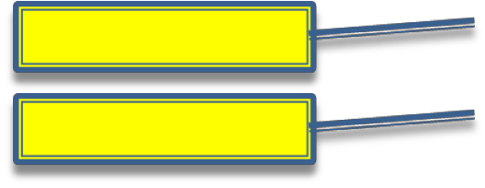
Naming System Events and Operations
System events (and their associated system operations) should be expressed at the level of intent rather than in terms of the physical input medium or interface widget level.
It also improves clarity to start the name of a system event with a verb (add..., enter..., end..., make...), as in since it emphasizes the command orientation of these events.
:Cashier
:System
Better name
enterItem(itemID, quantity)
Worse name
scan(itemID, quantity)

Slide 56



Operations Contracts
Use cases are the primary mechanism in the UP to describe system behavior, and
are usually sufficient.
However, sometimes a more detailed description of system behavior has value. Contracts for operations can help define system behavior.
A Domain Model
A visual representation of conceptual classes or real-world objects in a domain of interest.
Contracts
A detailed system behavior in terms of state changes to objects in the Domain Model, after a system operation has executed.

Slide 57

Operations Contracts
Operation:
Name of operation, and parameters.
Cross References:
Use cases this can occur within. (optional)
Preconditions:
Noteworthy assumptions about the state of the system or objects in the Domain Model before execution of the operation.
Postconditions:
The state of objects in the Domain Model after completion of the operation.

Slide 58

Operations Contracts
The postconditions describe changes in the state of objects in the Domain Model.
Domain Model state changes include instances created, associations formed or broken, and attributes changed.
(worse) Create a SalesLineItem.
Postconditions are not actions to be performed, during the operation; rather, they are declarations about the Domain Model objects that are true when the operation has finished. after the smoke has cleared.
Express postconditions in the past tense, to emphasize they are declarations about a state change in the past.
(better) A SalesLineItem was created. (worse) Create a SalesLineItem.

Slide 59

The spirit of post conditions: the stage and curtain
The system and its objects are presented on a theatre stage
Before the operation , take picture of the stage
Close the curtains on the stage and apply the system operation Open the curtains and take a second picture
Compare the before and after pictures, and express as post conditions the changes in the state of the stage (a SalesLineItem was created)

Slide 60

Contracts Vs. Use Cases
The use cases are the main repository of requirements for the project. They may
provide most or all of the detail necessary to know what to do in the design
If the details and complexity of the required state changes are awkward to capture in use cases, then write operation contracts

Slide 61

Guidelines: Contracts
To make Contracts:
Identify system operations from the SSDs
For system operations that are complex and subtle in their own results or which are not clear in the use case construct a contract
To describe the postconditions use:
-
-
-
Instance creation and deletion Attribute modification Association formed and broken

Slide 62

Operations
An operation is an abstraction, not an implementation. By contrast, a method (in the UML) is an implementation of an operation.
A UML operation has a signature (name and parameters), and also an operation specification, which describes the effects produced by executing the operation; the postconditions.
A UML operation specification may not show an algorithm or solution, but only the state changes or effects of the operation.

Slide 63

Operations contracts expressed with the OCL
Associated with the UML is a formal language: Object constraint Language (OCL) Which can be used to express constraints in models
The OCL defines an official format for specifying pre and post conditions for operations as :
System: makeNewSale()
Pre: <statements in OCL> Post:

Slide 64

Post conditions
To summarize, the post conditions fall into these categories:
i.
ii.
iii.
Instance creation and deletion.
Attribute modification.
Associations (to be precise, UML links) formed and broken.

Slide 65
i. Instance Creation and Deletion
After the itemID and quantity of an item have been entered, what new object should have been created? A SalesLineltem. Thus:
. A SalesLineltem instance sll was created (instance creation).

Slide 66

ii. Attribute Modification
After the itemID and quantity of an item have been entered by the cashier, what attributes of new or existing objects should have been modified? The quantity of the SalesLineltem should have become equal to the quantity parameter. Thus:
. sliquantity became quantity (attribute modification).

Slide 67

iii.
Associations Formed and Broken
After the itemID and quantity of an item have been entered by the cashier, what associations between new or existing objects should have been formed or broken? The new SalesLineltem should have been related to its Sale, and related to its ProductSpeciflcation. Thus:
. sli was associated with the current Sale (association formed).
. sli was associated with a ProductSpeciflcation, based on ItemID match (association formed).
A post-condition that breaks an association:
Consider an operation to allow the deletion of line items. The post-condition could read "The selected SalesLineltem’s association with the Sale was broken." In other domains, when a loan is paid off or someone cancels their membership in something, associations are broken.

Slide 68

Note the informal indication that it forms a relationship with a particular
Prod-uctSpecification.the one whose itemID matches the parameter. More fancy and formal language approaches are possible, such as using the Object Constraint Language (OCL). Recommendation: Keep it plain and simple.

Slide 69


Object-oriented Analysis and Design
Contract CO1: makeNewSale Operation: makeNewSale() Cross refer: Process Sale Preconditions: None Postconditions:
-A Sale instance s was created (instance creation)
-s was associated with the Register (association formed)
- attributes of s were initialized
:Cashier
:System
makeNewSale()
enterItem(itemID, quantity)
Description total
*[more items]
Contract CO2: enterItem
Operation: enterItem(itemID:ItemID,quantity:integer)
Cross refer: Process Sale
Preconditions: There is a sale underway Postconditions:
A SalesLineItem sli instance s was created (instance creation)
sli was associated with the currentSale(association formed)
sli.quantity became quantity (attribute modification)
sli was associated with a ProductSpecification based on itemID match (association formed)
endSale()
Total with taxes
makePayment(amount)
Change due, receipt

Slide 70


Object-oriented Analysis and Design
:Cashier
:System
Contract CO3: endSale Operation: endSale() Cross refer: Process Sale
Preconditions: There is a sale underway
Postconditions: sale.isComplete became true (attribute modification)
makeNewSale()
enterItem(itemID, quantity)
Description total
*[more items]
Contract CO4: makePayment Operation: makePayment(amount: Money) Cross refer: Process Sale
Preconditions: There is a sale underway Postconditions:
A Payment instance p was created (instance creation)
p.amountTender became amount (attrubute modification)
p was associated with the currentSale (association formed)
-The currentSale was associated with the Store (association formed);
(to add it to the historical log of completed sales)
endSale()
Total with taxes
makePayment(amount)
Change due, receipt

Slide 71



Object-oriented Analysis and Design
Analysis Model
System Sequence Diagram
:Cashier
:System
System Operation Contracts
Text use cases
enterItem(itemID, quantity)
System events and data
getTotal(itemID, quantity)
System operations
enterItem(..)
Design objects to handle system events
Design Model

Slide 72
New system operations
Create new system operations for point of sale system to handle different forms of payment:
i.
ii.
makeCreditPayment makeCheckPayment

Slide 73

New System Operation Contracts
System operations are an optional requirements artifact that adds fine detail regarding the results of a system operation
The use case text itself is sufficient at times The contracts are not necessary

Slide 74


Contract: makeCreditPayment
Operation : makeCreditPayment (creditAccountNumber, expiryDate)
Cross References: Use Cases: Process Sale
Preconditions: an underway sale exists and all items have been entered
Postconditions:
A credit payment pmt was created
pmt was associated with the current Sale Sale a CreditCard cc was created.
cc.number = creditAccountNumber, cc.expiryDate = expiryDate
cc was associated with pmt
A creditPaymentRequest cpr was created Pmt was associated with cpr
A ReceivaleEntry re was created
re was associated with the external AccountsReceivable
Sale was associated with the Store as a complete sale

Slide 75

Contract: makeCreditPayment
There exists a post condition indicating the association of a new receivable entry in accounts receivable
Although , this responsibility is outside the bounds of the system , the accounts receivable system is within the control of the business
The statement has thus been added as a correctness check
during testing , it is clear from this post condition that the accounts receivable system should be tested for the presence of a new receivable entry

Slide 76


Contract: makeCheckPayment
Operation: makeCheckPayment(driversLicenseNumber)
Cross References: use Cases: Process Sale
Preconditions: An underway sale exists and all items have been entered
Postconditions:
A CheckPayment pmt was created
Pmt was associated with the current Sale sale
A DriversLicense dl was created, dl.number = driversLicenseNumber
dl was associated with pmt
a CheckPaymentRequest cpr was created
pmt was associated with cpr
sale was associated with the Store as a completed sale

